Slide 1

Weather vs City Traffic
A DATA-DRIVEN MODEL FOR PREDICTING TRAFFIC DELAYS
PRESENTED BY
Linwei Zheng • Cai Rong Li • Christopher Neria • Mohamed K • Ibsan Hossain

Slide 2
Table of Contents
Data Collection
1
The Problem
2
Method & Process
3
4
Database Schema
5
API Integration &
Tableau Chart
6
Business Intelligence Dashboard
7
Tech Stack
8
Team Roles
9
Q&A

Slide 3
Introduction/Problem
The Challenge
Strategic Goal
• NYC traffic congestion is very unpredictable, and it affects commuters on a day-to-day basis
• Weather conditions like rain and temperatures have a major impact on traffic congestion
Our goal is to create a data model that uses weather data to analyze and predict traffic delays in New York City, to help provide insights for commuters and Transportation agencies.
Core Research Questions
What is the difference in traffic delay on rainy days vs non-rainy days?
How much does delay time increase as rainfall increases?
How does temperature affect traffic delays in NYC?
Stakeholders: Commuters • Transportation Agencies • City Planners

Slide 4
Method & Process
1
2
3
4
5
Data Collection
Preprocessing
Store in MySQL
Regression Model
Tableau Dashboard
Visual Crossing API
Clean & merge
datasets in Pandas
Append records
no overwrites
Rain → Delay time
Impact
A/B results +
Predictions for city planners
Commuter impact analysis

Slide 5
Data Collection
Source 2: NYC OpenData - DOT Traffic Speeds API
Data type: Real-time motor vehicle speeds by roadway segment
Metrics collected:
Average speed (mph)
Travel time (seconds)
Link coordinates (for geospatial analysis)
Congestion status
Update Frequency: Every 5 minutes (real-time)
Method: API endpoint → JSON → pandas DataFrame
Source 1: Visual Crossing Weather API
Data type: Historical weather data, real-time conditions, and 15-day forecasts
Free tier: 1,000 calls/day (sufficient for our needs)
Metrics collected:
Temperature (°F converted from Kelvin)
Rainfall (inches, last 3 hours)
Humidity (%)
Wind speed (mph)
Weather condition
Snow accumulation
Method: GET request → JSON → pandas DataFrame
Update Frequency: Every 5 minutes (real-time)
Source 3: NYC OpenData - Citi Bike System Data API
Data type: Real-time bike share availability and station occupancy
Metrics collected:
Available bikes per station
Available docks per station
Station status (active/inactive)
Station capacity
Total station count by borough
Bike utilization rates
Update Frequency: Real-time (1-2 minute intervals)
Method: API endpoint → JSON → pandas DataFrame

Slide 6
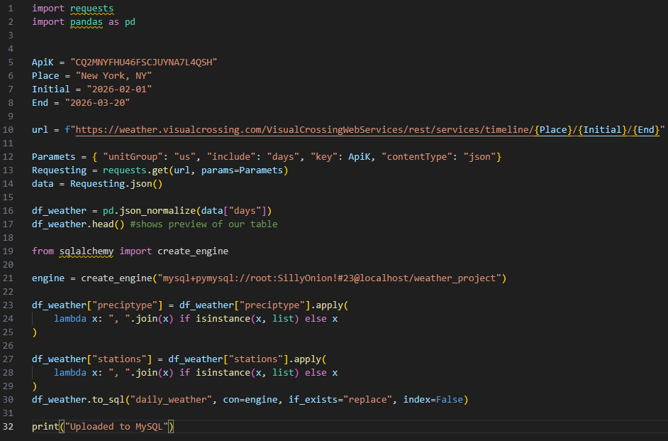
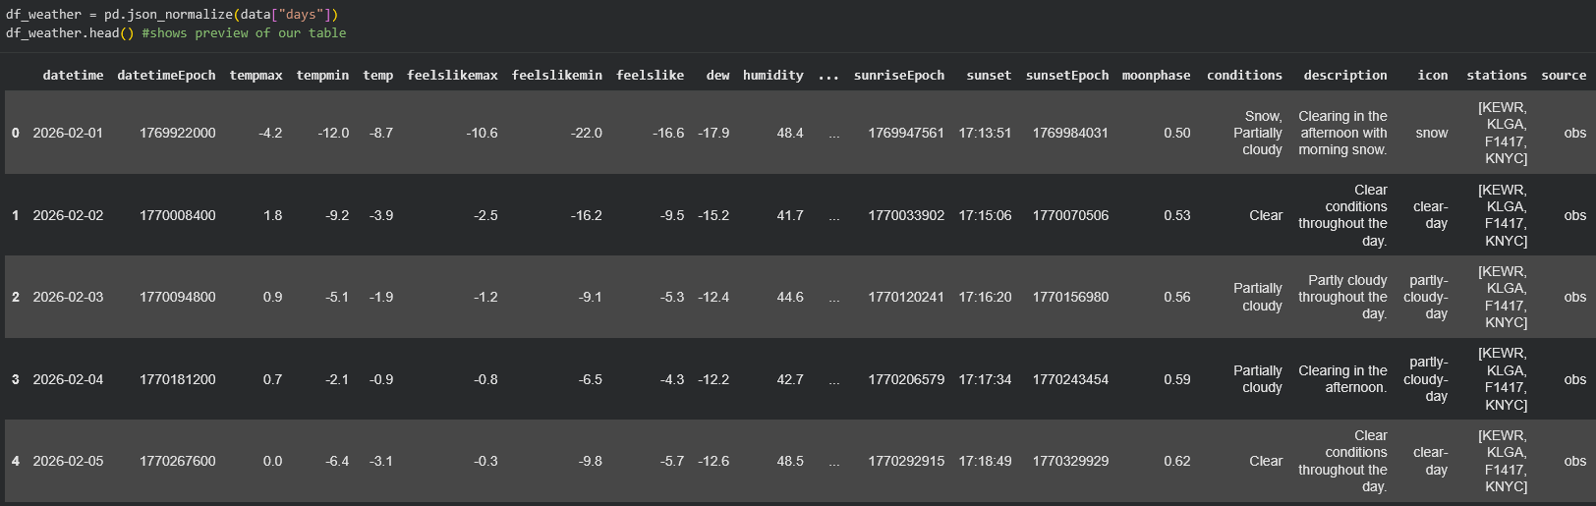
API Integration

Slide 7
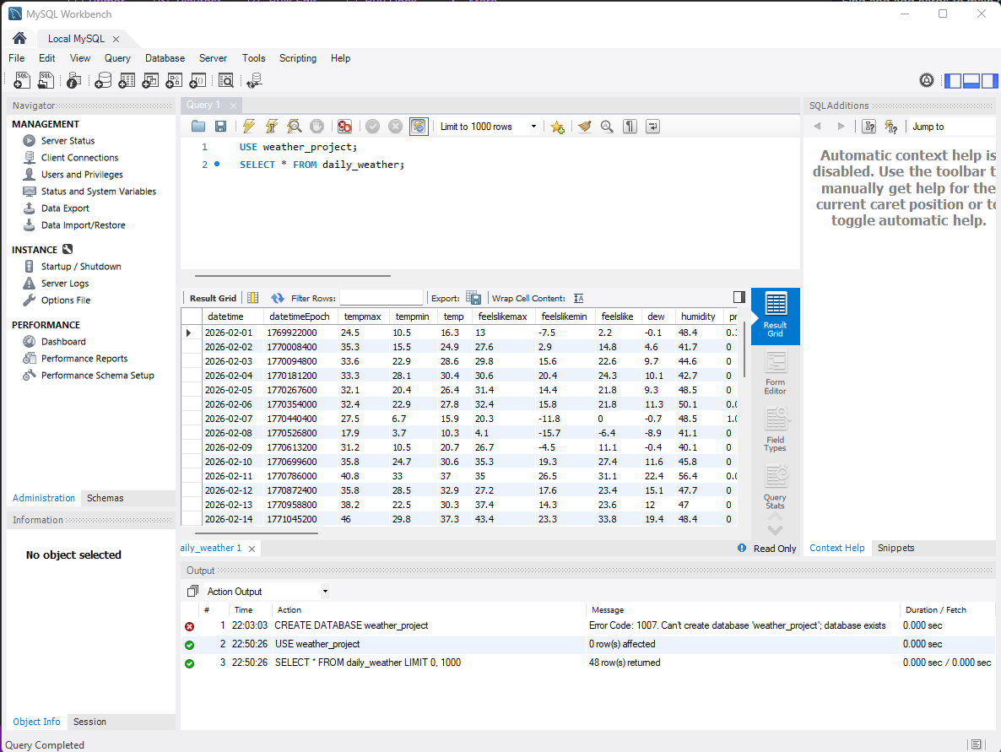
MySQL integration

Slide 8
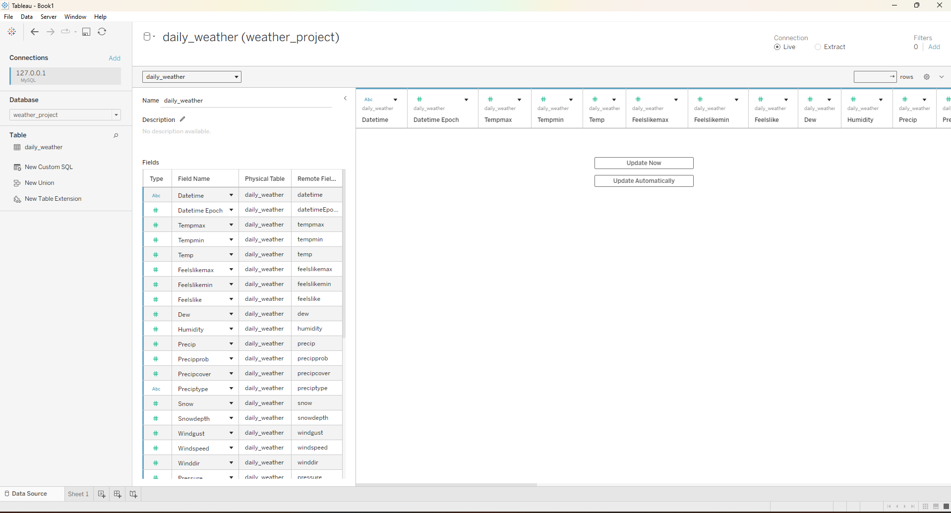
Tableau

Slide 9
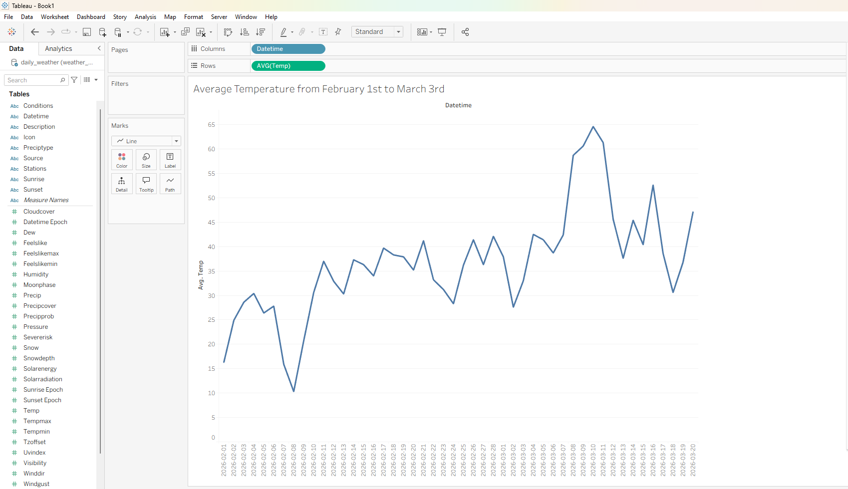
Tableau Cont.

Slide 10
Business Intelligence Dashboard
Rainfall vs Delay Scatter
Plots:
X-axis: Rainfall (inches)
Y-axis: Delay Time (minutes)
Trend line reveals: +2.3 minutes of delay per 0.1 inch of rain
One inch of rain adds approximately 23 minutes to NYC commutes
A/B Test Results
Model A (Weather Only): RMSE = 12.3 minutes
Model B (Weather + Yesterday's Traffic): RMSE = 8.7 minutes
Model B outperforms Model A by 29%, proving historical traffic patterns improve predictions
Borough Comparison Map
Geographic heat map of New York City
Color intensity represents average delay time per borough
Manhattan: 24 min average delay (highest congestion)
Staten Island: 12 min average delay (lowest congestion)

Slide 11
Tech Stack
Component | Technology | Why We Chose It
Source API | Visual Crossing + NYC Open Data | Free, stable, real data
ETL Language | Python 3.x | Industry standard
ETL Libraries | Requests, Pandas | Gold standard for data
Database | MySQL | Reliable, structured
Visualization | Tableau | Interactive dashboards

Slide 12
Team Roles
Member | Role
Linwei Zheng | Project Manager
Cai Rong Li | API & Pipeline
Christopher Neria | Data Cleaning
Mohamed K | Modeling
Ibsan Hossain | Dashboard

Slide 13


